Slide 1


PROJECT TITLE
IMAGE SIMILARITY DETECTION FOR CONTEXT BASED SEARCH
PRESENTED BY-
SUSHANT SINGH
MOHIT DIXIT
NAVNEET KUMAR
UNDER GUIDANCE OF -
MR. SARFARAZ SIR

Slide 2


PROBLEM STATEMENT
IMAGE PROCESSIING
IMAGE SEARCHING
Image processing is resource costly. (Especially if we do it on the fly during retrieval and search).
Search the similar type images .
2
3
4
5
COMPARINGIMAGE
DUPLICATE IMAGES
OBJECT DETECTION
Comparing images is hard job for peoples without using a technique.
How to find the similar type of images in your database.
Detect the object in image using the object detection algorithms.

Slide 3

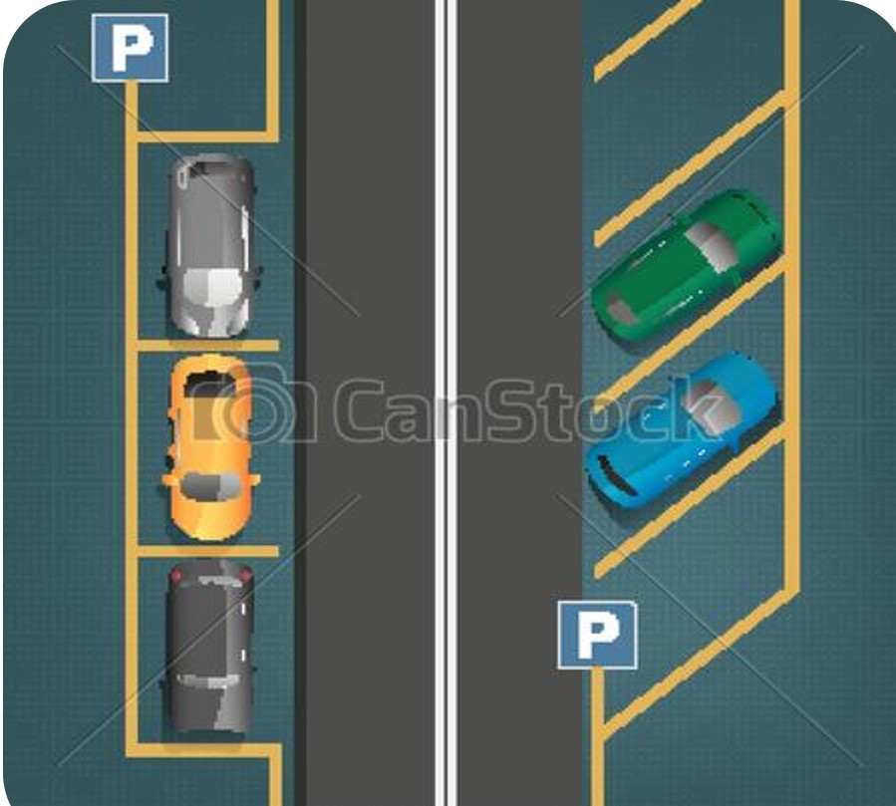
DIFFERENCE BETWEEN IMAGE SIMILARITY AND
IMAGE CLASSIFICATION
Let’s say you are looking at five cars parked in a road- two black car, a yellow, a blue and a dark-green car. For image classification models, these five cars are all just cars. It doesn’t concern itself with the color and other aspect of the car.
IMAGE SIMILARITY
For a similar image ranking model, it would look at the colors and other aspects of the cars as well. If a query image is a “black car”, the similar image ranking model would rank the “dark green car” higher than the “yellow car”.
IMAGE CLASSIFICATION
Image classification models may not fit directly to task of distinguishing fine-grained image similarity. The authors of the Deep Ranking paper propose to learn fine-grained image similarity with a deep ranking model, which characterizes the fine-grained image similarity relationship with a set of triplets.

Slide 4

INTRODUCTION
Image similarity detection is used to quantify the degree of visual and semantic similarity of the images.
Duplicate product detection, image clustering, visual search, and recommendation tasks are performed with this technology in modern applications.
Example-“The future of search will be about pictures …rather than keywords.”
Our project is on find similarity in images using AI algorithm.
The matric used to measure the similarity between images is probably the most important thing in building image similarity models. While there are different metrics one can use to define the similarity, the most popular ones are L1-norm (also known as Manhattan distance) and L2 norm( also known as Euclidean distance).

Slide 5
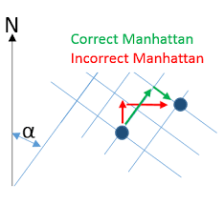
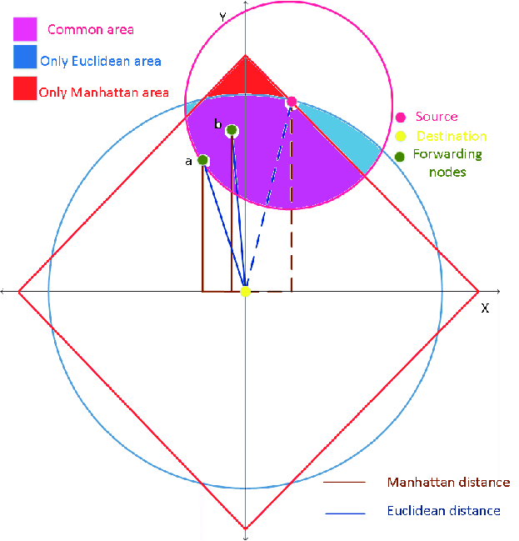
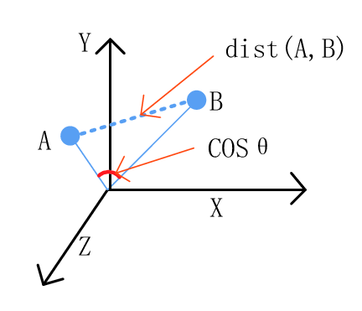
MANHATTAN AREA( L1)
Also known as Manhattan Distance or Taxicab norm. L1 Norm is the sum of the magnitudes of the vectors in a space. It is the most natural way of measure distance between vectors, that is the sum of absolute difference of the components of the vectors. In this norm, all the components of the vector are weighted equally.
EUCLIDEAN AREA ( L2 )
Is the most popular norm, also known as the Euclidean norm. It is the shortest distance to go from one point to another.

Slide 6
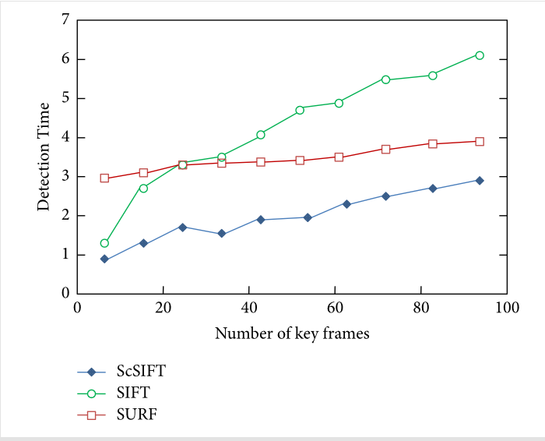
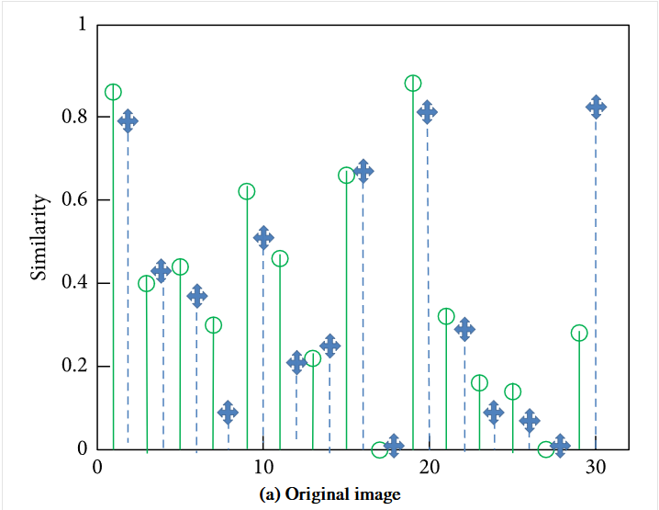
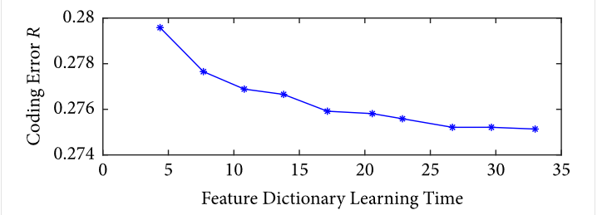
PRINCIPLE OF SCSIFT ALGORITHM
The implementation of image similarity acceleration detection algorithm based on sparse coding is mainly divided into three subprocesses: sparse dictionary learning algorithm, query image offline sparse coding algorithm, and real-time matching algorithm of images.

Slide 7
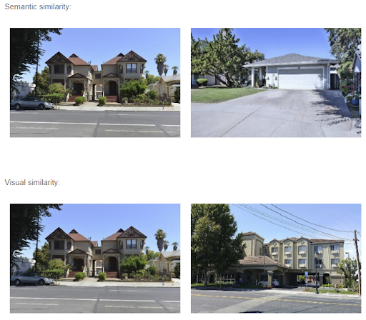
WE ARE MAKING SIMILARITY MODEL
Initially, image similarity models considered category-level image similarity.
For example, two images are considered similar as long as they belong to the same category. This category-level image similarity is not sufficient for the search-by-example image search application. Search by query image requires the distinction of differences between images within the same category- to Recognized the fine grained differences in the similar images.

Slide 8

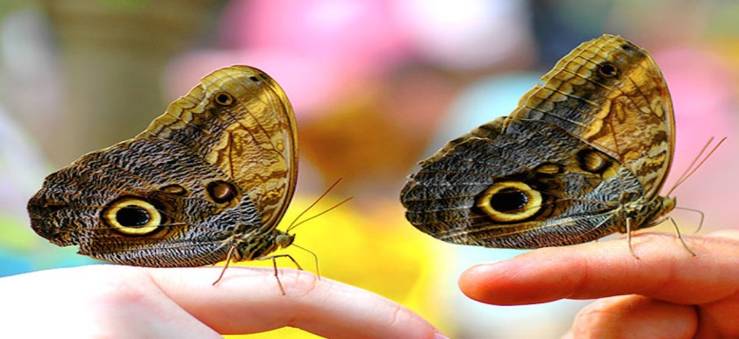

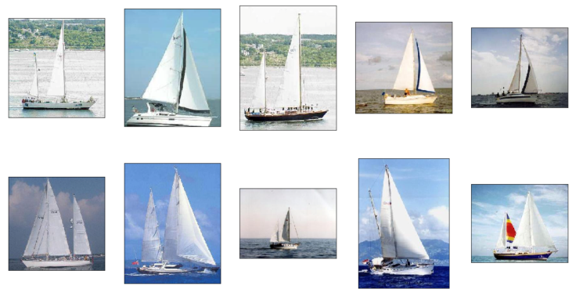
PROPOSED SYSTEM
COMPARING TWO IMAGES
PROCESS USER DATA
IMAGE SEARCH
The image similarity API processes two images and output a distance the two images are from each other. The distance value lets you know how visually similar the two images are a score of ‘0’ being identical.
Going through dataset to find duplicates is painful. Let the image similarity algorithm do it for you! With the distance value , you can figure out the change in two images after a period of time or discover duplicates in your user data.
Search by Image is a feature that uses reverse image search and allows users to search for related images just by uploading an image or image . App accomplishes this by analyzing the submitted picture and constructing a mathematical model of it using advanced algorithms.

Slide 9

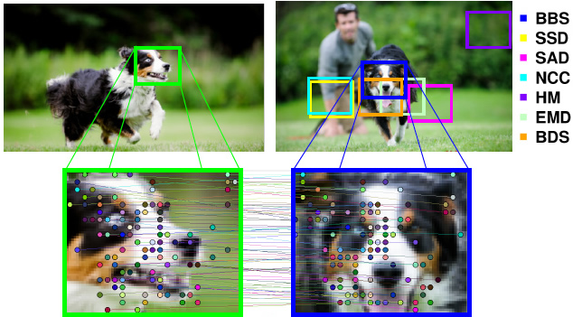
OBJECT AND SCOPE
Clean our duplicate Data.
To understand Image contents is important.
To detect similarity of Images.
Context similarity based search and ranking.
Low–level optimization to minimize memory.
Understanding of context with the images.

Slide 10


FEASIBILITY STUDY
A feasibility study is an analysis that takes all of a project's relevant factors into account—including economic, technical, legal, and scheduling considerations—to ascertain the likelihood of completing the project successfully. Project managers use feasibility studies to discern the pros and cons of undertaking a project before they invest a lot of time and money into it.
SCHEDULE/TIME HORIZON FEASIBILITY
ECONOMICAL FEASIBILITY
Economic feasibility elements include, but are not limited to:
Increased agency revenue,
Decreased agency revenue,
Increased agency costs,
Decreased agency costs,
Increased revenue to other agencies and/or the general public,
Decreased revenue to other agencies and/or the general public,
Increased costs to other agencies and/or the general public,
Decreased costs to other agencies and/or the general public, and,
Other public benefits.
It includes how strong the reaction of staff will be towards the development of new system with in the given time. So resistant to change is identified.
After feasibility study feasibility report is prepared and submitted to the management.

Slide 11


FEASIBILITY STUDY
BEHAVIOURAL FEASIBILITY
TECHNICAL FEASIBILITY
It determines whether the technology needed for the proposed system is available and how it can be integrated within the organization . Technical evaluation must also assess whether the staff have technical expert to understand and use the new technology.
Initiatives with technological complexities, such as projects that will use novel technology not significantly tested, or that will adapt technology not fully operational in the same conditions as the project under analysis;
Projects requiring difficult engineering innovations, such as works of art or complex transport structures (tunnels or bridges);
Projects built in particularly uncertain geo-technical conditions with consequences for a major part of the project costs (that is, a tunnel project or a large sea bridge.
It is concerned with human ,organisational and political aspects.
It includes two ways-
1.Technical performance:
It includes issues such as whether the system can provide the right information for organization ’ s personnel at right time and right place.
2.Acceptance within the organisation:
It determines the general attitudes and job skills of existing personnel and whether any changes in job work will be acceptable by the current users.

Slide 12
FUNCTIONAL REQUIRMENT
SR.NO. | REQ NO. | REQUIRMENTS
1. | R1.1 | Installation of application
2. | R1.2 | Start Application
3. | R1.3 | Input By User
4. | R1.4 | Details Checking
5. | R1.5 | Prediction
6. | R1.6 | Output shown on screen

Slide 13
NON-FUNCTIONAL REQUIRMENT
CATEGORY | REQUIRMENTS
USABILITY | User must be able install the application.
RELIABILITY | App permission would important and will not use any private data.
PERFORMANCE | This software will able to give good performance on most of the OS.
SUPPORTABILITY | This software supports all window above window 7.
IMPLEMENTATION | All user must access the software by opening it in window device.
OPERATION | All the operation performed by the settings in the software.
LEGAL | The software should be used as required by local law.

Slide 14
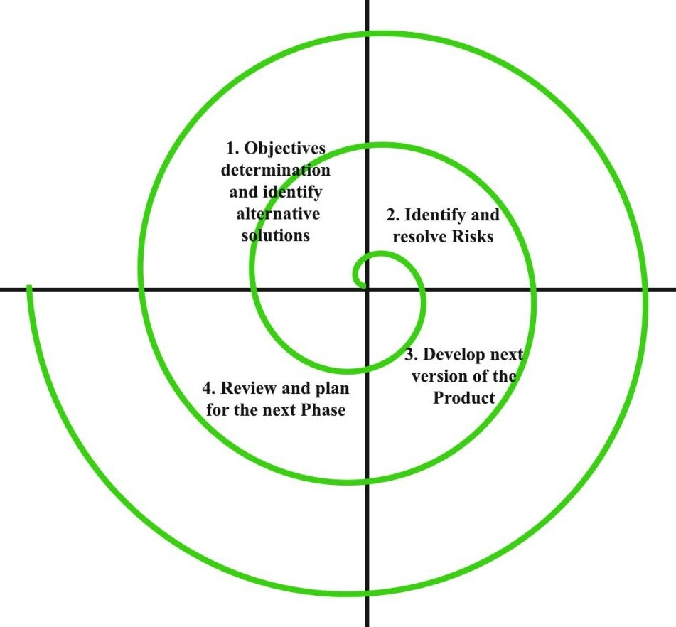
SYSTEM ANALYSIS
METHODOLOGIES USED
The spiral model, initially proposed by Boehm, is an evolutionary software process model that couples the iterative feature of prototyping with the controlled and systematic aspects of the linear sequential model.
It implements the potential for rapid development of new versions of the software. Using the spiral model, the software is developed in a series of incremental releases. During the early iterations, the additional release may be a paper model or prototype. During later iterations, more and more complete versions of the engineered system are produced.

Slide 15
user and role’s
In this model “image similarity detection for context based search” the role’s of user are:
First of all user will have to select the process which he wants to do on images.
User’s will have to upload the images according to their need.
User’s will have to submit the images with the requirements for the process.
User’s can the see the result of the process.
user’s can download the result.

Slide 16
System analysis (Gantt chart)
Task | 4Jan-30Jan | 31Jan-9Feb | 10Feb-12Mar | 13Mar-16Apr | 17Apr-22Apr | 23Apr-28Apr
Develop project proposal | 27 days
Analysis |  | 10 days
Designing |  |  | 30 days
Coding |  |  |  | 34days
Unit Testing |  |  |  |  | 5 days
Implementation |  |  |  |  |  | 5 days

Slide 17
Resources(hardware)
Hardware Requirements
Client Side
Server Side
Processor | Dual Core or above
RAM | 1 GB
Disk space | 500 GB
Monitor | 15”
Others | Keyboard, mouse, Internet Connection
Processor | Dual Core or above
RAM | 1 GB
Disk space | 500 GB
Monitor | 15”
Others | Keyboard, mouse, Internet Connection

Slide 18
Resources(software)
Software Requirements
Client Side
Server Side
Web Browser (Google Chrome, Firefox, IE9 or above)
Windows 7 or above/linux
Web Browser (Google Chrome, Firefox, IE9 or above)
Windows 7 or above / Linux
VS code
SQL lite Manager
Python 3.7
Flask

Slide 19
ASSUMPTIONS
THE PROPOSED SYSTEM IS DESIGNED WITH THE HELP OF AI, SIMILARITY OF IMAGES
USER MUST BE AWARE OF LANGUAGE AND BASIC CONTROL PRESENT ON THE APPLICATION
APPLICATION INTERFACE FOR THE USER SHOULD BE UNDERSTANDLE AND INTERACTIVE

Slide 20
user characteristics
To use this software user must have following characteristics:
Educational Background: User must be educated
Language: User must know the language of the python language
Computing skills: User have computing skills that he/she knows how to use the software
Feasibility: The user must be feasible to use this software

Slide 21
PROCESS DESCRIPTION
This module deals with the clustering algorithm that assigns the datapoints to the clusters iteratively by shifting points towards the mode.
05
Data base management
04
This modules deals with filtering of images using convolution algorithm that modifies the value of each pixel in an image by using information from neighboring pixels.
Sc Sift Algorithm
03
Here we will use one of database management system from MySQL, Postrregal SQL , Oracle, Microsoft SQL Server for the data management.
Pixel Max pooling System
02
Image convolution and Filtering
01
In this module, we will convert continuous image context attribute into a finite set of time with no loss of image context by using max pooling.
Image collection
In this module ,we will collect a lot of images from the different sources including the websites and social media. All images will be stored in database of the system.

Slide 22
PROCESS DESCRIPTION
Here user can choose the model on which he want to work and compile the tasks of the model before the add the module to the module.
10
Model training
09
: In this module, we will find matching and tracking over image sequences is presented. The goal is that a quadrotor helicopter autonomously approaches a selected target
Model creation and compiling
08
In this module , we trained the system elements according to a model of the image similarity detection for context based searching.
User dashboard system
07
Real time image matching algorithm
06
Here we will create a dashboard for user to check the similarity of the images and search the similar images.
Sparse dictionary learning
Here we will find a sparse representation of the input data as sparse coding in the form of a linear combination of basic elements as well as those basic elements themselves.

Slide 23
PROCESS DESCRIPTION
This model manages the display dynamically as the user interface which interact the user better. There will be more option for display management.
15
Preference manager
14
This module helps to detect instances of objects in image and predict the elements and values of the image for the detection of the similarity.
Dynamic display manager
13
This module deals about the preference of the image processing for the similarity detection and search similar type images.
Image uploading system
12
. Image recognition and prediction
11
In this module, we will convert continuous image context attribute into a finite set of time with no loss of image context by using max pooling.
Model train Evaluation and visualization
Here we will do evalaution module by module (task by task).and visualize the whole modules as a system after adding all module.

Slide 24
OPEN SYSTEM
UPLOAD IMAGES
PROCESSING
CONVOLATION AND FILTERING
MAXPOOLING
USE CASE DIAGRAM
SC SHIFT ALGORITHM
USER
MATCHING AND DETECTION
SYSTEM
FIND RESULT
VIEW RESULT

Slide 25
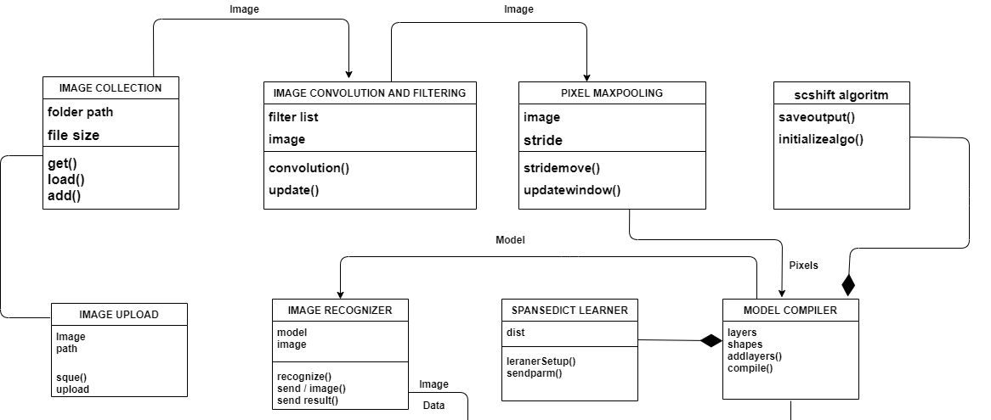
UML DIAGRAM

Slide 26
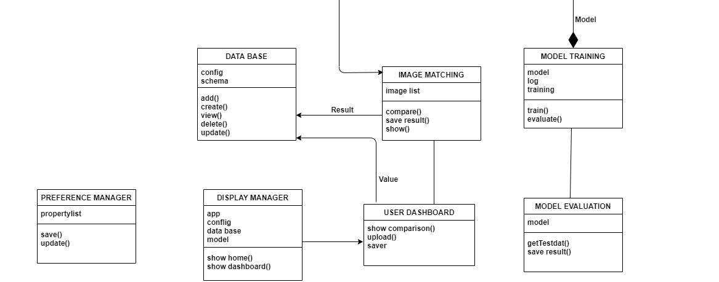

Slide 27
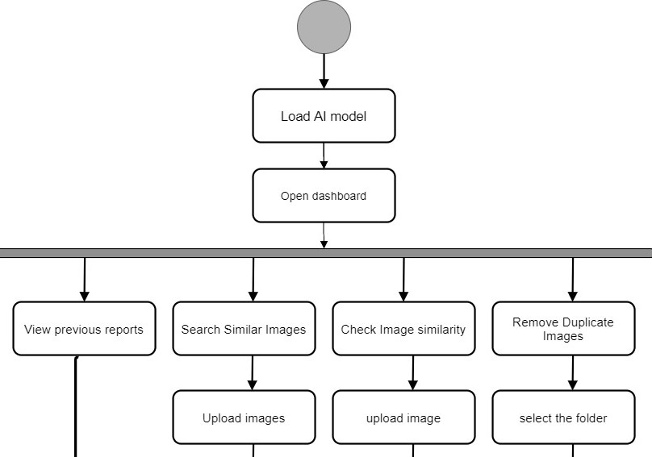
ACTIVITY DIAGRAM
MODULES

Slide 28
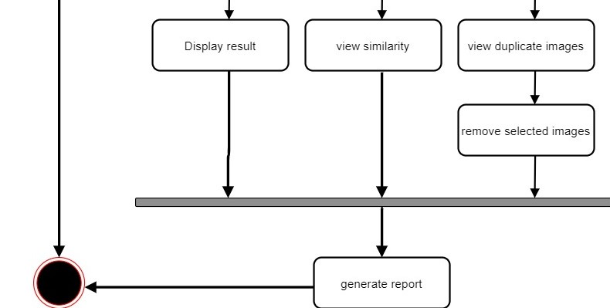

Slide 29

FUTURE SCOPE
In the future search will be about pictures rather than keywords.
visual search, and recommendation tasks are performed with this technology
An advantage of visual search is that it relies entirely on item appearance. There is no need for other data such as bar codes,QR codes, product names,
a source of inspiration so the visual search has the potential to transform how we shop for the home

Slide 30
CONCLUSION
Image similarity detection is a hot issue in the field of multimedia information processing.
Current image similarity detection methods are mainly based on global features or local features. Image similarity matching method based on global feature is fast but has the disadvantage of poor robustness. Image similarity matching method based on local feature is just the opposite. Aiming at the problem of high computational complexity and low efficiency based on the local feature detection method, an algorithm for image similarity detection based on sparse coding is proposed. The algorithm improves the detection speed by sparsely coding the local features and indexing them. The experimental results show that, compared with the traditional image similarity detection algorithm based on local feature, the algorithm can improve the detection speed while ensuring the detection efficiency. In the future work, we will further combine global and local features to ensure the best balance between detection accuracy and speed.

Slide 31
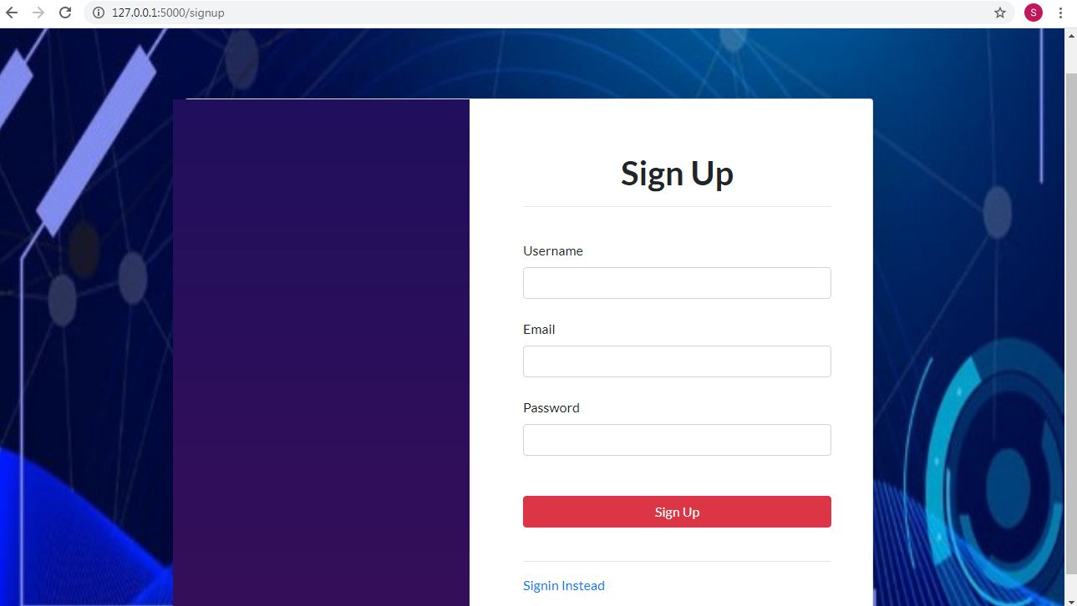
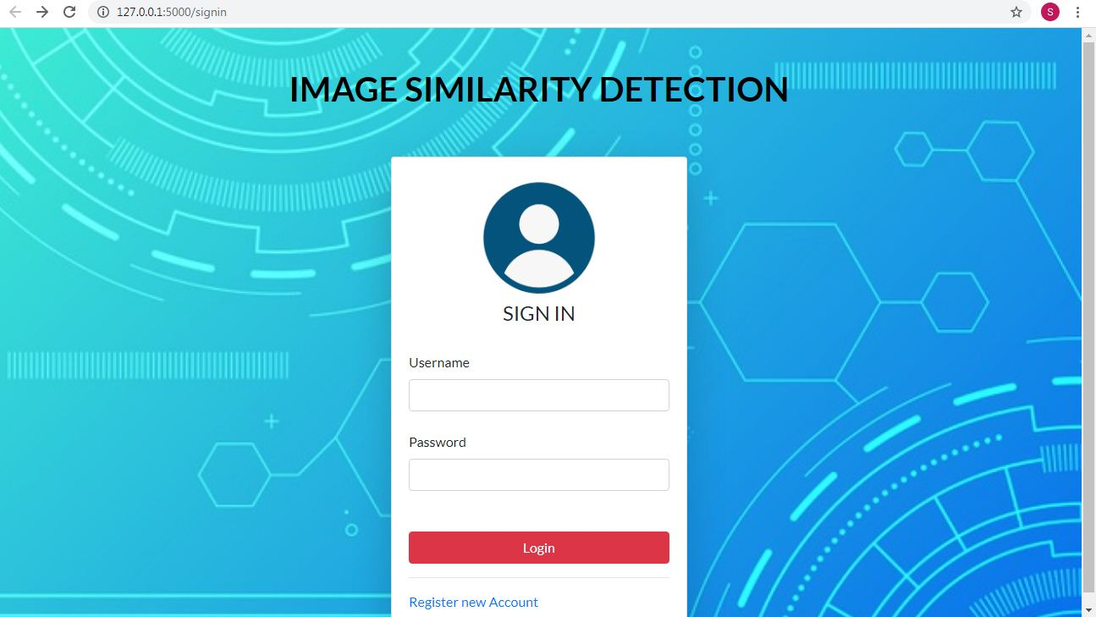
SCREEN SHORTS
SIGN-UP PAGE SIGN-IN PAGE

Slide 32
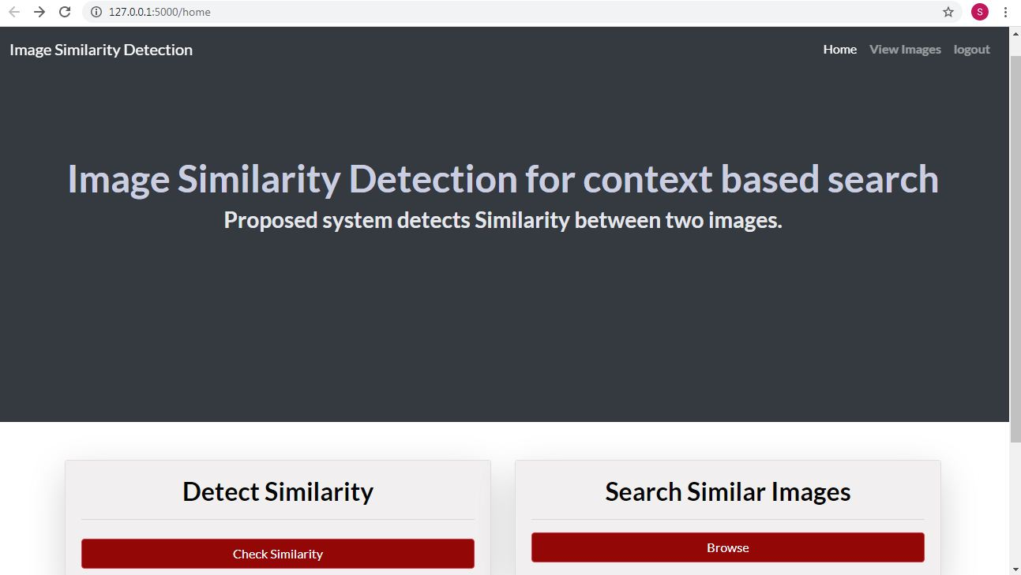

HOME PAGE

Slide 33
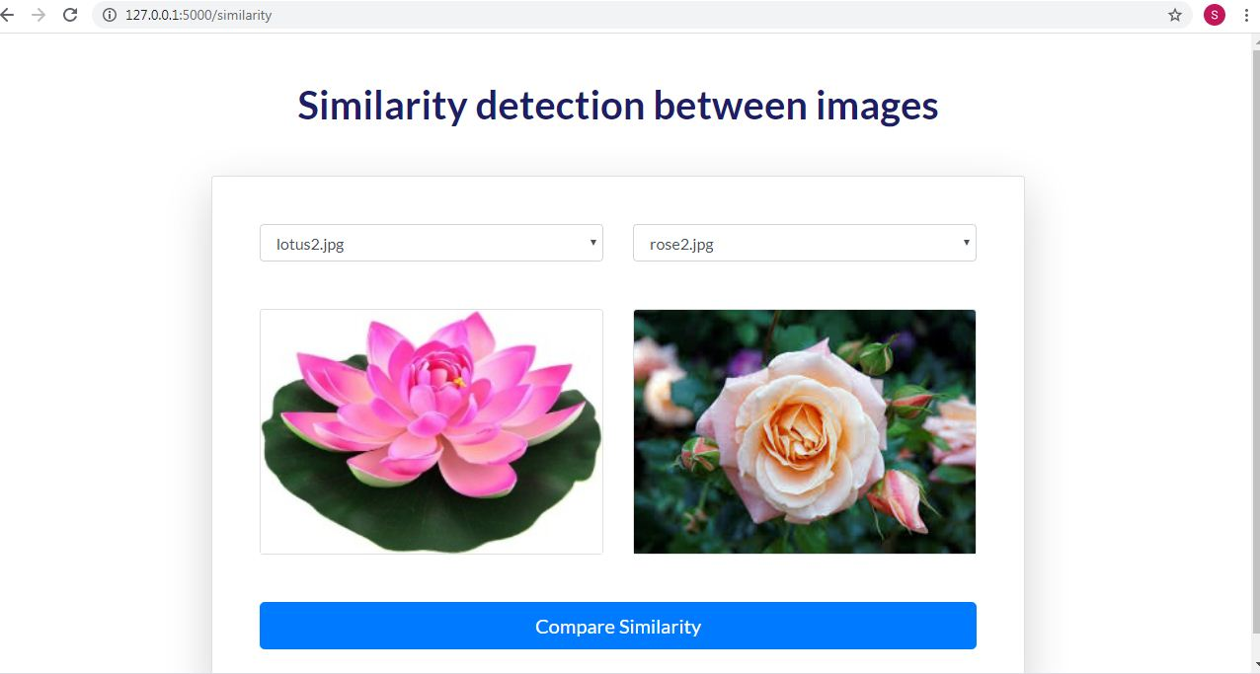
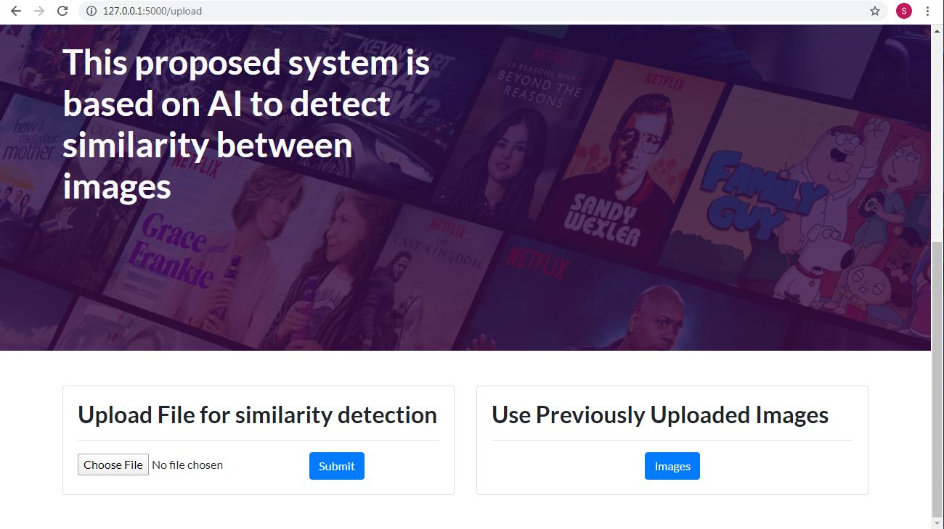
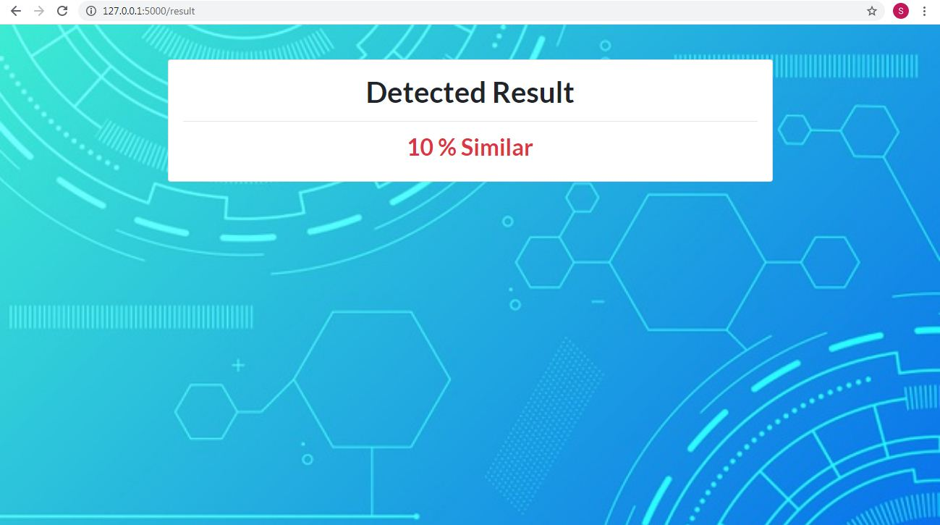
UPLOAD IMAGE FOR
SIMILARITY DETECTION

Slide 34

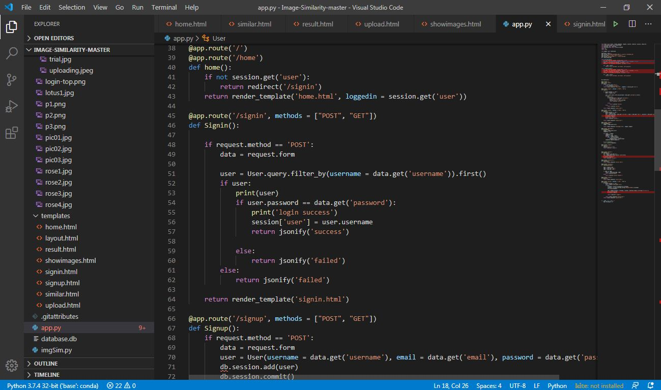

Slide 35


Slide 36


